Slide 1
SPACE SUIT HEALTH
MONITOR

Slide 2
OBJECTIVE
The main objective of the Space Suit Health Monitoring System is to check the astronaut’s health in real-time.
It measures body temperature, heart rate, oxygen level, and humidity inside the suit and sends the data to the ground station.
This helps to detect any health problem early and keep the astronaut safe during the space mission.

Slide 3
INTRODUCTION
The PLSS(portable life support system) is like the heart of the space suit it controls the oxygen, temperature, humidity, and pressure inside the suit.
When an abnormal condition occurs, the PLSS automatically detects, responds, and protects the astronaut.
Oxygen Sensor (SpO₂):Oxygen level goes too low . PLSS increases oxygen flow from the tank to maintain proper breathing level. It sends an alert to the ground station.
Humidity Sensor :Humidity too high inside the suit PLSS activates the dehumidifier or adjusts air circulation to reduce moisture .

Slide 4
PROPOSED METHODOLOGY
1.PowerSupply : Provides necessary power to the ESP32 .
2. Sensor Data Collection:DHT11 sensor measures the temperature and humidity inside the space suit.Max30100 sensor measure heart beat,Max30102 sensor measure oxygen level.
3. Data Processing (ESP32):The ESP32 microcontroller collects and processes all the sensor readings.
4. IoT Data Transmission : The processed data is transmitted wirelessly to a cloud platform.

Slide 5
TECHNICAL APPROACH
Hardware Components:
ESP32 Microcontroller.
DHT11 Sensor.
Heartbeat Sensor.
SpO₂ Sensor .
Power Supply Unit.
2. Software Components :
Arduino IDE.
IoT Platform.
Embedded C ++

Slide 6
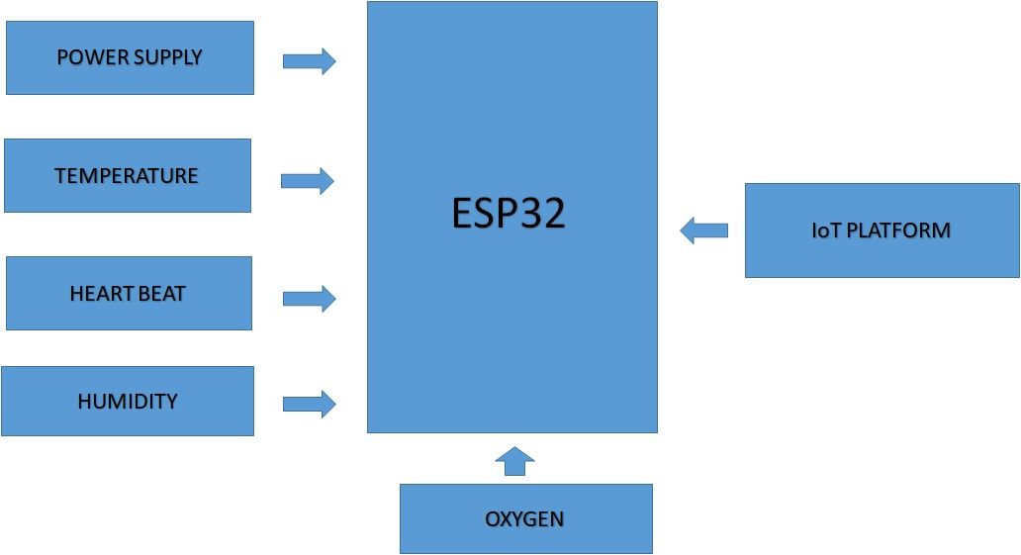
BLOCK DIAGRAM

Slide 7
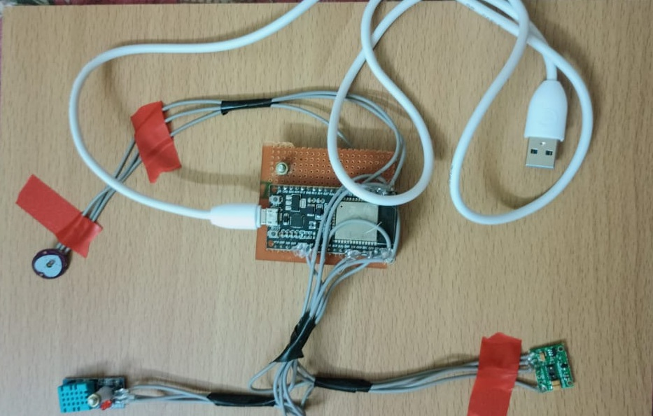
Model

Slide 8
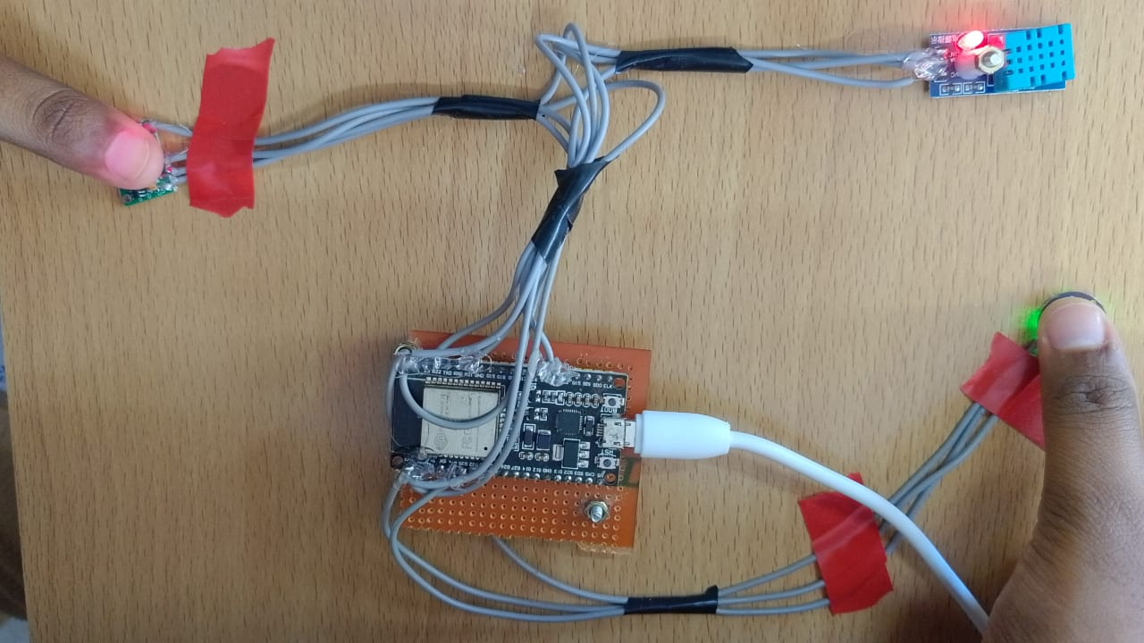
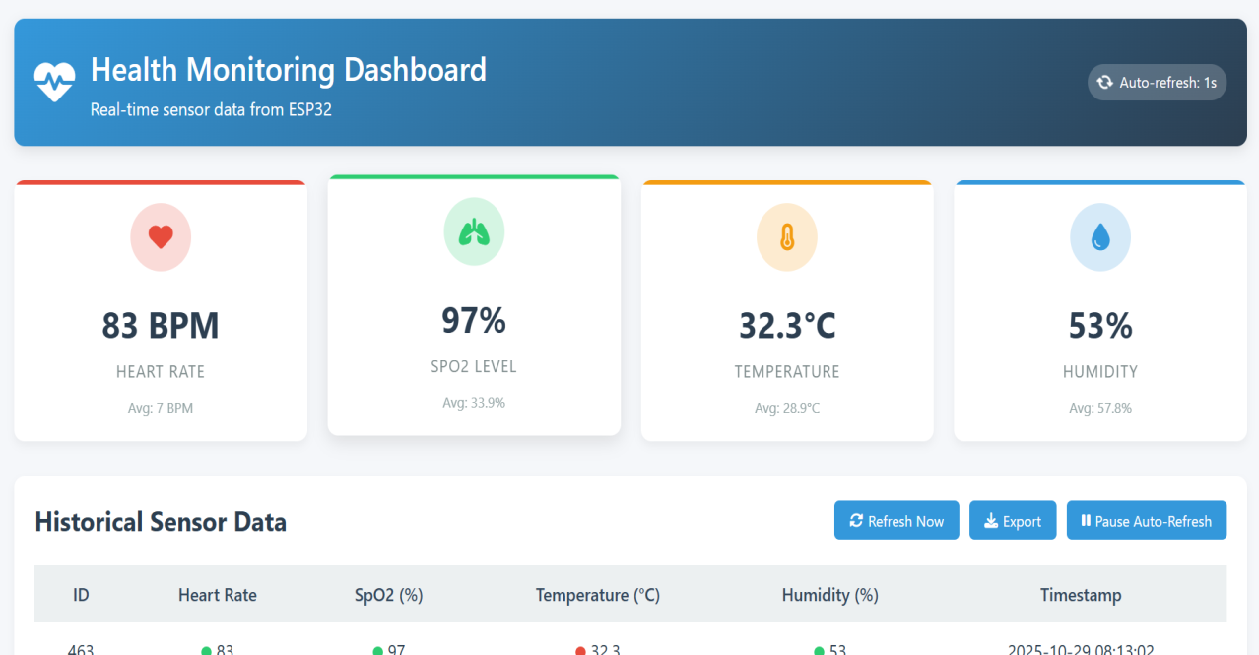
INPUT AND OUTPUT FORMAT
INPUT
OUTPUT

Slide 9
Difference Between Existing System and Implemented System
S.No | Existing System | Implemented System
1 | Data is monitored manually. | Data is automatically monitored using sensors.
2 | No real-time health tracking for astronauts. | Provides real-time monitoring and alert system.
3 | Delay in sending information to ground station. | Data is transmitted instantly through wireless communication.
4 | High risk of missing critical health conditions. | Immediate alerts help prevent health issues.
5 | No integration of humidity, temperature, and oxygen sensors. | Includes sensors to track temperature, heartbeat, oxygen, and humidity.
6 | Requires human supervision continuously. | System works automatically and reduces manual effort.

Slide 10
COMPLETE DESCRIPTION
The Space Suit Health Monitoring System is designed to enhance astronaut safety during space missions.
In space, monitoring vital signs is critical because environmental conditions can change rapidly and immediate medical assistance isn’t available.
This system integrates biosensors within the suit to measure real-time health data.

Slide 11
All sensors are connected to the ESP32 microcontroller, which processes the data and uploads it to a cloud-based IoT platform.
Ground control can view live readings such as temperature, heart rate, and SpO₂ from anywhere.
If any abnormal conditions occur (like high body temperature, low oxygen level, or irregular pulse), an alert is sent instantly, helping to prevent health risks and improving astronaut safety and mission success

Slide 12
FEASIBILITY AND VIABILITY
Tested in space missions and works well without bothering the astronaut.
Sends health data to Earth for doctors to watch in real time.
Can work for long missions with smart design and reliable parts.
Potential Challenges and Risks Sensors may fail due to space conditions like radiation and extreme temperatures.
Data signals might be delayed or lost, affecting quick health checks.
Suit comfort or movement may be affected by sensor parts.
Power sources need to last long without adding too much weight.

Slide 13
IMPACT AND BENEFITS
Enhances astronaut health and safety by providing real-time monitoring of vital signs and environmental conditions inside the space suit.
Facilitates early detection of health anomalies or emergencies, enabling timely interventions and reducing risks during missions.
Continuous monitoring offers immediate feedback to astronauts and ground medical teams, enhancing decision-making.
Increases astronaut comfort by monitoring suit conditions such as temperature, pressure, and humidity.

Slide 14
LITERATURE REVIEW
THEME: Narrative review exploring musculoskeletal changes in microgravity and proposing wearable sensors and robotic suits (e.g., smart textiles, exoskeletons) as compact, intelligent solutions for long-term missions | Publication: arXiv preprint, April 2024
THEME: A NASA workshop white paper promoting a future paradigm of AI-driven, autonomous “Precision Space Health” systems—aggregating biosensor data, predicting personalized health risks, and supporting deep-space crew decision-making | Publication: arXiv preprint, December 2021

Slide 15
Thank you

